Slide 1
Unit 4
Object Oriented Databases

Slide 2
Chapter Outline
1 Overview of O-O Concepts
2 O-O Identity, Object Structure and Type Constructors
3 Encapsulation of Operations, Methods and Persistence
4 Type and Class Hierarchies and Inheritance
5 Complex Objects
6 Other O-O Concepts
7 Summary & Current Status

Slide 3
Introduction
Traditional Data Models:
Hierarchical
Network (since mid-60’s)
Relational (since 1970 and commercially since 1982)
Object Oriented (OO) Data Models since mid-90’s
Reasons for creation of Object Oriented Databases
Need for more complex applications
Need for additional data modeling features
Increased use of object-oriented programming languages
Commercial OO Database products –
Several in the 1990’s, but did not make much impact on mainstream data management

Slide 4
Overview of Object-Oriented Concepts
Main Claim:
OO databases try to maintain a direct correspondence between real-world and database objects so that objects do not lose their integrity and identity and can easily be identified and operated upon
Object:
Two components:
state (value) and behavior (operations)
Similar to program variable in programming language, except that it will typically have a complex data structure as well as specific operations defined by the programmer

Slide 5
Overview of Object-Oriented Concepts
In OO databases, objects may have an object structure of arbitrary complexity in order to contain all of the necessary information that describes the object.
In contrast, in traditional database systems, information about a complex object is often scattered over many relations or records, leading to loss of direct correspondence between a real-world object and its database representation.

Slide 6
Overview of Object-Oriented Concepts
The internal structure of an object in OOPLs includes the specification of instance variables, which hold the values that define the internal state of the object.
An instance variable is similar to the concept of an attribute, except that instance variables may be encapsulated within the object and thus are not necessarily visible to external users

Slide 7
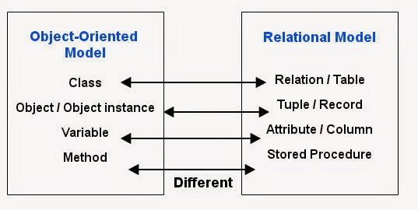
Comparison: RDB vs OODB

Slide 8
Overview of Object-Oriented Concepts
Some OO models insist that all operations a user can apply to an object must be predefined. This forces a complete encapsulation of objects.
To encourage encapsulation, an operation is defined in two parts:
signature or interface of the operation, specifies the operation name and arguments (or parameters).
method or body, specifies the implementation of the operation.

Slide 9
Interface and Class
An interface specifies only behavior of an object type and is typically not instantiable ( that is, no objects are created corresponding to an interface).
Although an interface may have state properties (attributes and relationships) as a part of the specifications.
Hence an interface serves to define operations that can be inherited by other interfaces, as well as by classes that define the user defined objects for a particular application.
A class specifies both state (attributes) and behavior (operations) of an object type, and is instantiable. Hence, database and application objects are typically created based on the user specified class declarations that form a database schema.

Slide 10
Overview of Object-Oriented Concepts
Operations can be invoked by passing a message to an object, which includes the operation name and the parameters.
The object then executes the method for that operation.
This encapsulation permits modification of the internal structure of an object, as well as the implementation of its operations, without the need to disturb the external programs that invoke these operations

Slide 11
Overview of Object-Oriented Concepts
Some OO systems provide capabilities for dealing with multiple versions of the same object (a feature that is essential in design and engineering applications).
For example, an old version of an object that represents a tested and verified design should be retained until the new version is tested and verified:
very crucial for designs in manufacturing process control, architecture , software systems …..

Slide 12
Overview of Object-Oriented Concepts
Operator polymorphism:
This refers to an operation’s ability to be applied to different types of objects; in such a situation, an operation name may refer to several distinct implementations, depending on the type of objects it is applied to.
This feature is also called operator overloading

Slide 13
Object Identity, Object Structure, and Type Constructors
Unique Identity:
An OO database system provides a unique identity to each independent object stored in the database.
This unique identity is typically implemented via a unique, system-generated object identifier, or OID
The main property required of an OID is that it be immutable
Specifically, the OID value of a particular object should not change.
This preserves the identity of the real-world object being represented.

Slide 14
Object Identity, Object Structure, and Type Constructors
Type Constructors:
In OO databases, the state (current value) of a complex object may be constructed from other objects (or other values) by using certain type constructors.
The three most basic constructors are atom, tuple, and set.
Other commonly used constructors include list, bag, and array.
The atom constructor is used to represent all basic atomic values, such as integers, real numbers, character strings, Booleans, and any other basic data types that the system supports directly.

Slide 15
User-Defined Types (UDTs) and Complex Structures for Objects or Constructors
In ODBs, a complex type may be constructed from other types by nesting of type constructors. The three most basic constructors are atom, struct (or tuple), and collection.
Atom: This is the simplest type of constructor, and it is used to represent basic atomic values, such as integers, real numbers, character strings, Booleans, and any other basic data types that the system supports directly.
Struct or Tuple: This constructor is used to represent a collection of values, where the order of the values is significant. For example, a tuple could be used to represent a person's name, address, and phone number.

Slide 16
User-Defined Types (UDTs) and Complex Structures for Objects or Constructors
Collection (or multivalued) type constructors include the set(T), list(T), bag(T), array(T), and dictionary(K,T) type constructors.
The main characteristic of a collection type is that its objects or values will be a collection of objects or values of the same type that may be unordered (such as a set or a bag) or ordered (such as a list or an array).
Set: set of values of same type with duplication not allowed.
e.g.: {123,456,789}.
Multiset or Bag: This constructor is similar to a set, but duplicates are allowed. For example, a bag could be used to represent a person's favorite colors or a list of the words that a person has used in a document.
e.g.: {123,456,678,123}

Slide 17
User-Defined Types (UDTs) and Complex Structures for Objects or Constructors
List: ordered collection of items of the same type with infinite size.
e.g.: [123,456,678]
Array: similar to list but fixed size. The array constructor creates a single-dimensional array of elements of the same type. The main difference between array and list is that a list can have an arbitrary number of elements whereas an array typically has a maximum size.
Dictionary constructor creates a collection of two tuples (K, V), where the value of a key K can be used to retrieve the corresponding value V.

Slide 18
Object Identity, Object Structure, and Type Constructors
Example 1 (contd.)
We use i₁, i₂, i₃, . . . to stand for unique system-generated object identifiers. Consider the following objects:
o₁ = (i₁, atom, ‘Houston’)
o₂ = (i₂, atom, ‘Bellaire’)
o₃ = (i₃, atom, ‘Sugarland’)
o₄ = (i₄, atom, 5)
o₅ = (i₅, atom, ‘Research’)
o₆ = (i₆, atom, ‘1988-05-22’)
o₇ = (i₇, set, {i1, i2, i3})

Slide 19
Object Identity, Object Structure, and Type Constructors
Example 1(contd.)
o₈ = (i₈, tuple, <dname:i₅, dnumber:i₄, mgr:i₉, locations:i₇, employees:i₁₀, projects:i₁₁>)
o₉ = (i₉, tuple, <manager:i₁2, manager_start_date:i₆>)
o₁₀ = (i₁₀, set, {i₁₂, i₁₃, i₁₄})
o₁₁ = (i₁₁, set {i₁₅, i₁₆, i₁₇})
o₁₂ = (i₁₂, tuple, <fname:i₁₈, minit:i₁₉, lname:i₂₀, ssn:i₂₁, . . ., salary:i₂₆, supervi­sor:i₂₇, dept:i₈>)
. . .

Slide 20
Object Identity, Object Structure, and Type Constructors
Example 1 (contd.)
The first six objects listed in this example represent atomic values.
Object seven is a set-valued object that represents the set of locations for department 5; the set refers to the atomic objects with values {‘Houston’, ‘Bellaire’, ‘Sugarland’}.
Object 8 is a tuple-valued object that represents department 5 itself, and has the attributes DNAME, DNUMBER, MGR, LOCATIONS, and so on.

Slide 21
Object Identity, Object Structure, and Type Constructors
Example 2:
This example illustrates the difference between the two definitions for comparing object states for equality.
o₁ = (i₁, tuple, <a₁:i₄, a₂:i₆>)
o₂ = (i₂, tuple, <a₁:i₅, a₂:i₆>)
o₃ = (i₃, tuple, <a₁:i₄, a₂:i₆>)
o₄ = (i₄, atom, 10)
o₅ = (i₅, atom, 10)
o₆ = (i₆, atom, 20)

Slide 22
Object Identity, Object Structure, and Type Constructors
Example 2 (contd.):
In this example, The objects o1 and o2 have equal states, since their states at the atomic level are the same but the values are reached through distinct objects o4 and o5.
However, the states of objects o1 and o3 are identical, even though the objects themselves are not because they have distinct OIDs.
Similarly, although the states of o4 and o5 are identical, the actual objects o4 and o5 are equal but not identical, because they have distinct OIDs.

Slide 23
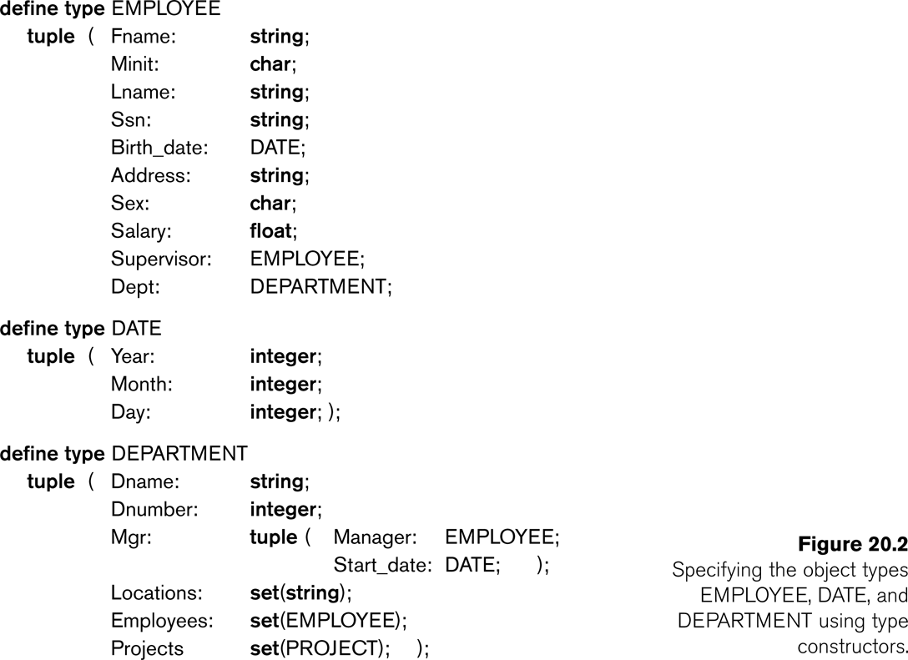
Object Identity, Object Structure, and Type Constructors

Slide 24
Encapsulation of Operations, Methods, and Persistence
Encapsulation
One of the main characteristics of OO languages and systems
Related to the concepts of abstract data types and information hiding in programming languages

Slide 25
Encapsulation of Operations, Methods, and Persistence
Specifying Object Behavior via Class Operations:
The main idea is to define the behavior of a type of object based on the operations that can be externally applied to objects of that type.
In general, the implementation of an operation can be specified in a general-purpose programming language that provides flexibility and power in defining the operations.

Slide 26
Encapsulation of Operations, Methods, and Persistence
Specifying Object Behavior via Class Operations (contd.):
For database applications, the requirement that all objects be completely encapsulated is too stringent.
One way of relaxing this requirement is to divide the structure of an object into visible and hidden attributes (instance variables).

Slide 27
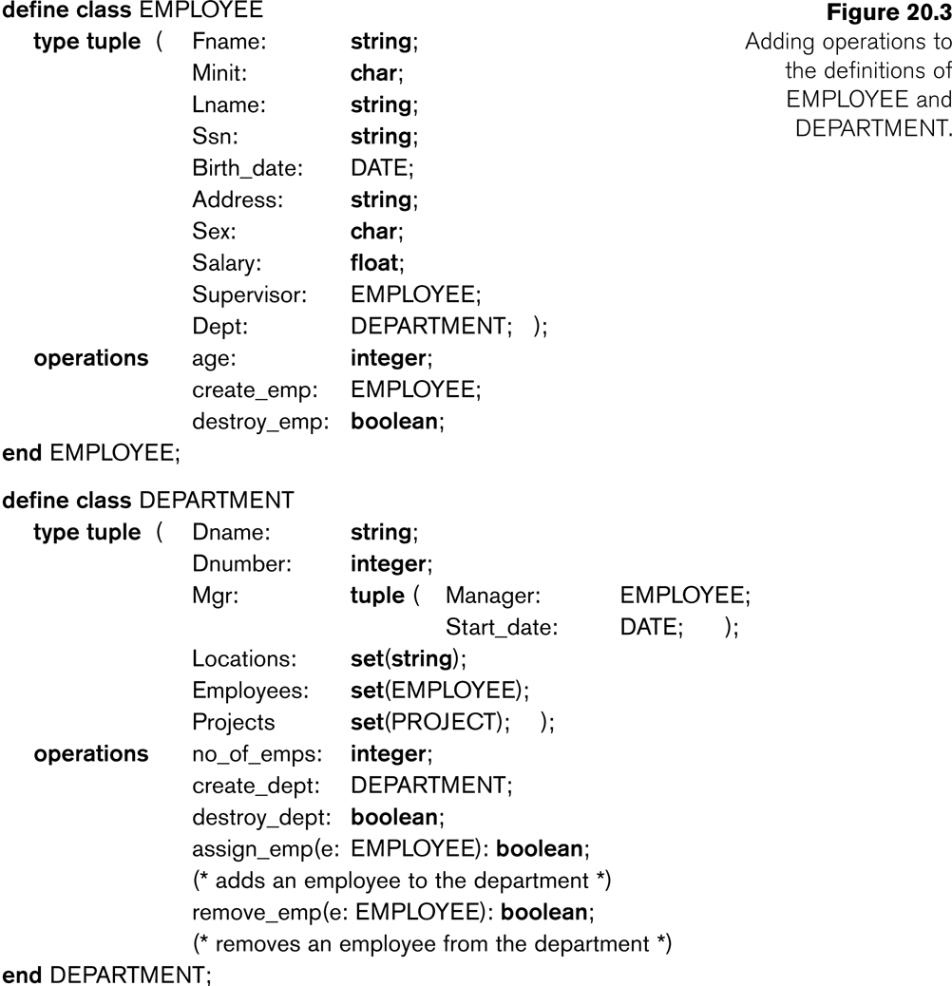
Encapsulation of Operations, Methods, and Persistence

Slide 28
Encapsulation of Operations, Methods, and Persistence
Specifying Object Persistence via Naming and Reachability:
Naming Mechanism:
Assign an object a unique persistent name through which it can be retrieved by this and other programs.
Reachability Mechanism:
Make the object reachable from some persistent object.
An object B is said to be reachable from an object A if a sequence of references in the object graph lead from object A to object B.

Slide 29
Encapsulation of Operations, Methods, and Persistence
Specifying Object Persistence via Naming and Reachability (contd.):
In traditional database models such as relational model or EER model, all objects are assumed to be persistent.
In OO approach, a class declaration specifies only the type and operations for a class of objects. The user must separately define a persistent object of type set (DepartmentSet) or list (DepartmentList) whose value is the collection of references to all persistent DEPARTMENT objects

Slide 30
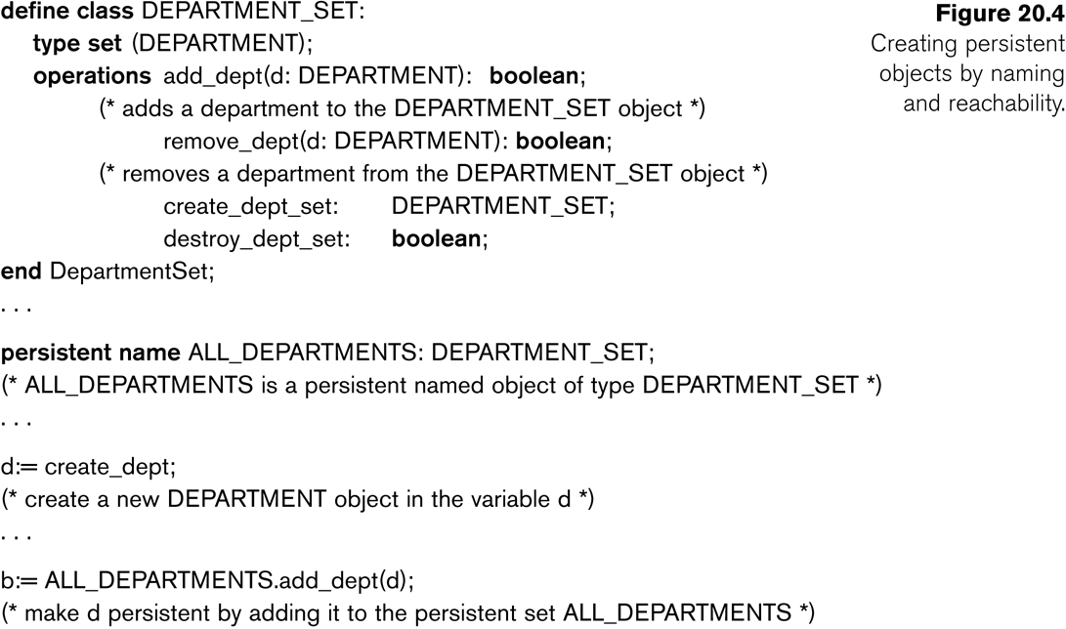
Encapsulation of Operations, Methods, and Persistence

Slide 31
Type and Class Hierarchies and Inheritance
Type (class) Hierarchy
A type in its simplest form can be defined by giving it a type name and then listing the names of its visible (public) functions
When specifying a type in this section, we use the following format, which does not specify arguments of functions, to simplify the discussion:
TYPE_NAME: function, function, . . . , function
Example:
PERSON: Name, Address, Birthdate, Age, SSN

Slide 32
Type and Class Hierarchies and Inheritance
Subtype:
When the designer or user must create a new type that is similar but not identical to an already defined type
Supertype:
It inherits all the functions of the subtype

Slide 33
Type and Class Hierarchies and Inheritance
Example (1):
PERSON: Name, Address, Birthdate, Age, SSN
EMPLOYEE: Name, Address, Birthdate, Age, SSN, Salary, HireDate, Seniority
STUDENT: Name, Address, Birthdate, Age, SSN, Major, GPA
OR:
EMPLOYEE subtype-of PERSON: Salary, HireDate, Seniority
STUDENT subtype-of PERSON: Major, GPA

Slide 34
Type and Class Hierarchies and Inheritance
Example (2):
Consider a type that describes objects in plane geometry, which may be defined as follows:
GEOMETRY_OBJECT: Shape, Area, ReferencePoint
Now suppose that we want to define a number of subtypes for the GEOMETRY_OBJECT type, as follows:
RECTANGLE subtype-of GEOMETRY_OBJECT: Width, Height
TRIANGLE subtype-of GEOMETRY_OBJECT: Side1, Side2, Angle
CIRCLE subtype-of GEOMETRY_OBJECT: Radius

Slide 35
Type and Class Hierarchies and Inheritance
Extents:
In most OO databases, the collection of objects in an extent has the same type or class.
However, since the majority of OO databases support types, we assume that extents are collections of objects of the same type for the remainder of this section.
Persistent Collection:
This holds a collection of objects that is stored permanently in the database and hence can be accessed and shared by multiple programs
Transient Collection:
This exists temporarily during the execution of a program but is not kept when the program terminates

Slide 36
Complex Objects
Unstructured complex object:
These is provided by a DBMS and permits the storage and retrieval of large objects that are needed by the database application.
Typical examples of such objects are bitmap images and long text strings (such as documents); they are also known as binary large objects, or BLOBs for short.
This has been the standard way by which Relational DBMSs have dealt with supporting complex objects, leaving the operations on those objects outside the RDBMS.

Slide 37
Complex Objects
Structured complex object:
This differs from an unstructured complex object in that the object’s structure is defined by repeated application of the type constructors provided by the OODBMS.
Hence, the object structure is defined and known to the OODBMS.
The OODBMS also defines methods or operations on it.

Slide 38
Other Objected-Oriented Concepts
Polymorphism (Operator Overloading):
This concept allows the same operator name or symbol to be bound to two or more different implementations of the operator, depending on the type of objects to which the operator is applied
For example + can be:
Addition in integers
Concatenation in strings (of characters)

Slide 39
Other Objected-Oriented Concepts
Multiple Inheritance and Selective Inheritance
Multiple inheritance in a type hierarchy occurs when a certain subtype T is a subtype of two (or more) types and hence inherits the functions (attributes and methods) of both supertypes.
For example, we may create a subtype ENGINEERING_MANAGER that is a subtype of both MANAGER and ENGINEER.
This leads to the creation of a type lattice rather than a type hierarchy.

Slide 40
Other Objected-Oriented Concepts
Versions and Configurations
Many database applications that use OO systems require the existence of several versions of the same object
There may be more than two versions of an object.
Configuration:
A configuration of the complex object is a collection consisting of one version of each module arranged in such a way that the module versions in the configuration are compatible and together form a valid version of the complex object.

Slide 41
Summary
Object identity:
Objects have unique identities that are independent of their attribute values.
Type constructors:
Complex object structures can be constructed by recursively applying a set of basic constructors, such as tuple, set, list, and bag.
Encapsulation of operations:
Both the object structure and the operations that can be applied to objects are included in the object class definitions.

Slide 42
Summary
Programming language compatibility:
Both persistent and transient objects are handled uniformly. Objects are made persistent by being attached to a persistent collection.
Type hierarchies and inheritance:
Object types can be specified by using a type hierarchy, which allows the inheritance of both attributes and methods of previously defined types.
Extents:
All persistent objects of a particular type can be stored in an extent. Extents corresponding to a type hierarchy have set/subset constraints enforced on them.

Slide 43
Summary
Support for complex objects:
Both structured and unstructured complex objects can be stored and manipulated.
Polymorphism and operator overloading:
Operations and method names can be overloaded to apply to different object types with different implementations.
Versioning:
Some OO systems provide support for maintaining several versions of the same object.

Slide 44
Thank you

